Slide 1

Flight delays
Sarah Henry
Final project presentation

Slide 2
Project brief and starting questions
How does weather impact flight delays?
How does Newark airport compares to other New York Airports
Other factors for delays?
Can we predict which flights will be delayed?

Slide 3
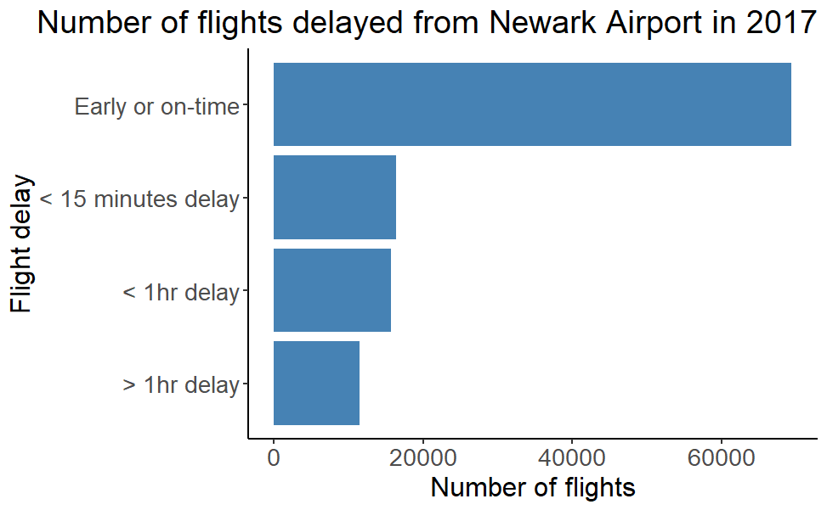
Flight Delays
Total flights
= 112942
% on time/early
= 61.4 %
% flights >1hr delay = 10.1 %

Slide 4
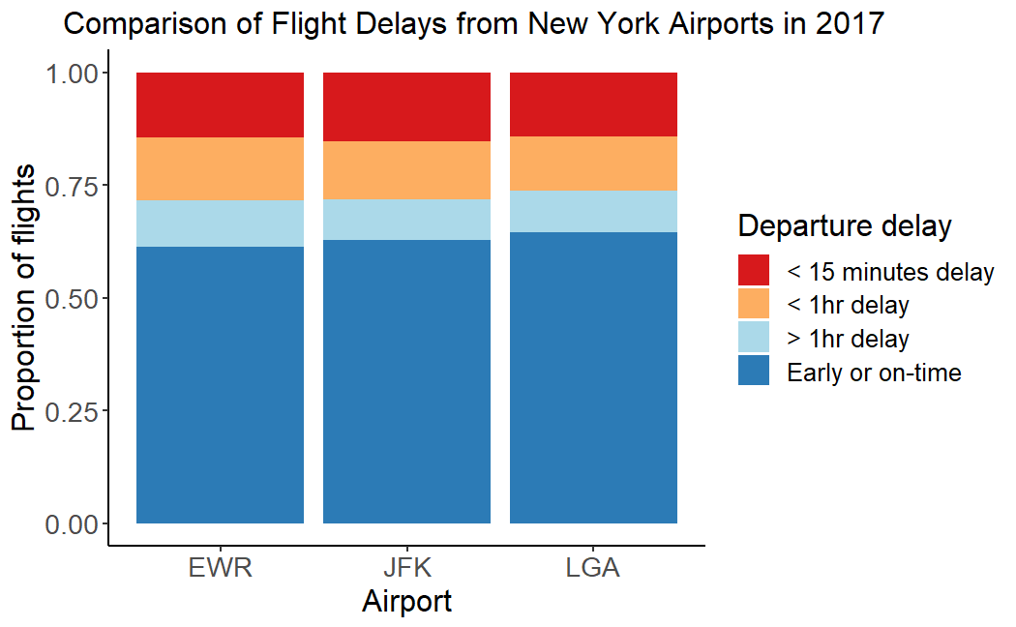
Comparison with other airports

Slide 5
Weather data
Data contained weather records for
Rain
Wind speed
Wind gusts
Humidity
Temperature
Dewpoint
Visibility
Wind Direction

Slide 6
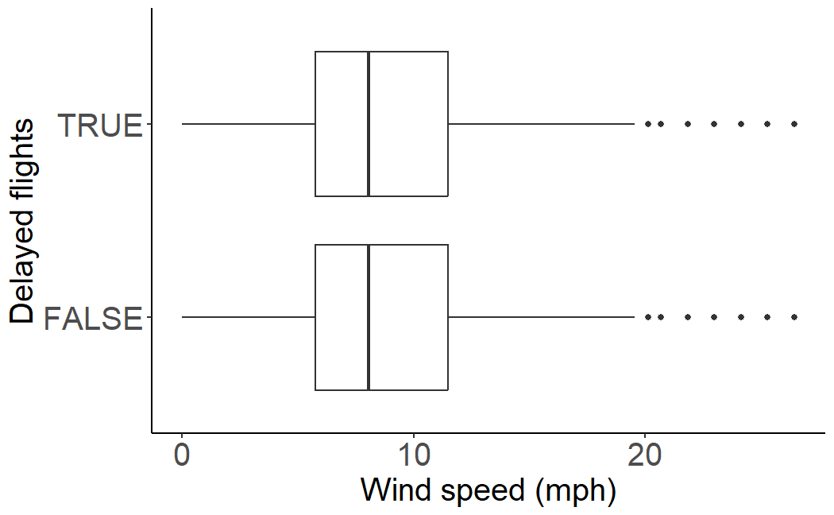
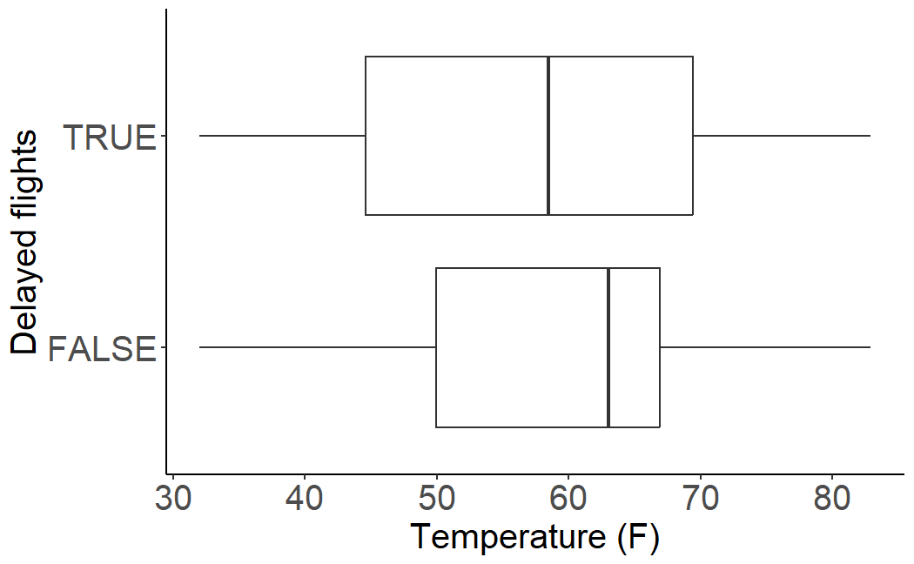
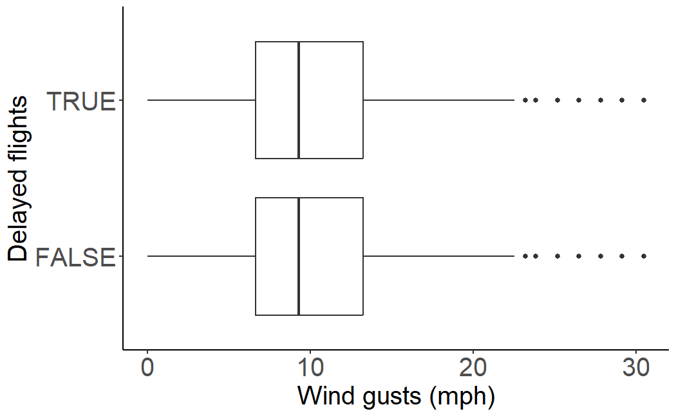
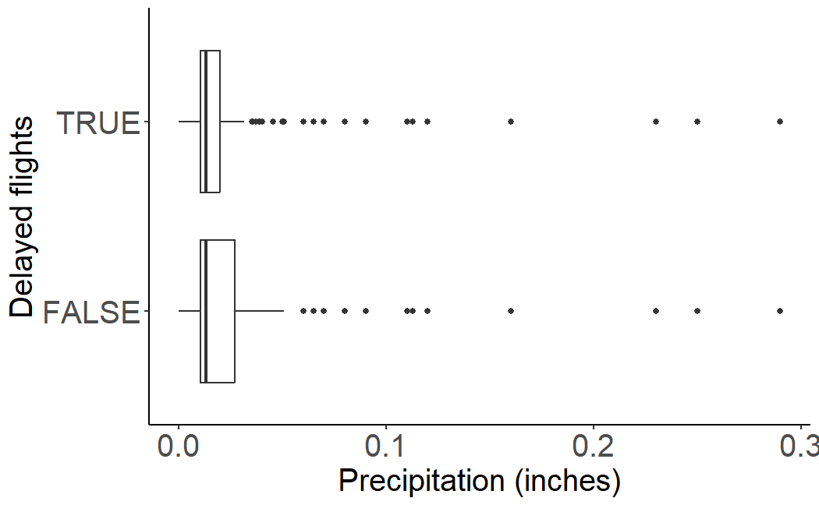
Wind speed
temperature
Wind gusts
Precipitation

Slide 7
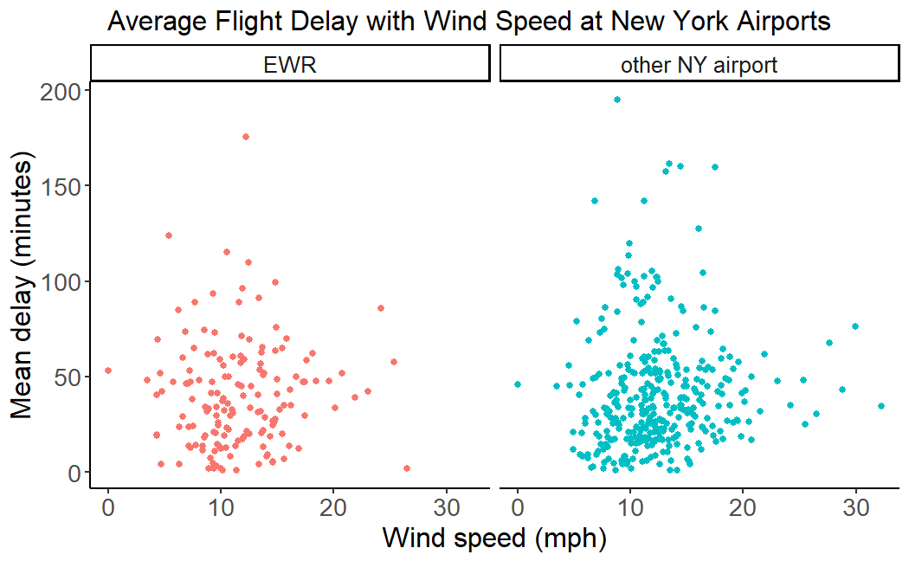
Impact of weather

Slide 8
Other factors
Data included:
Airport location
Aircraft and carrier
Journey information
Time of day, year

Slide 9
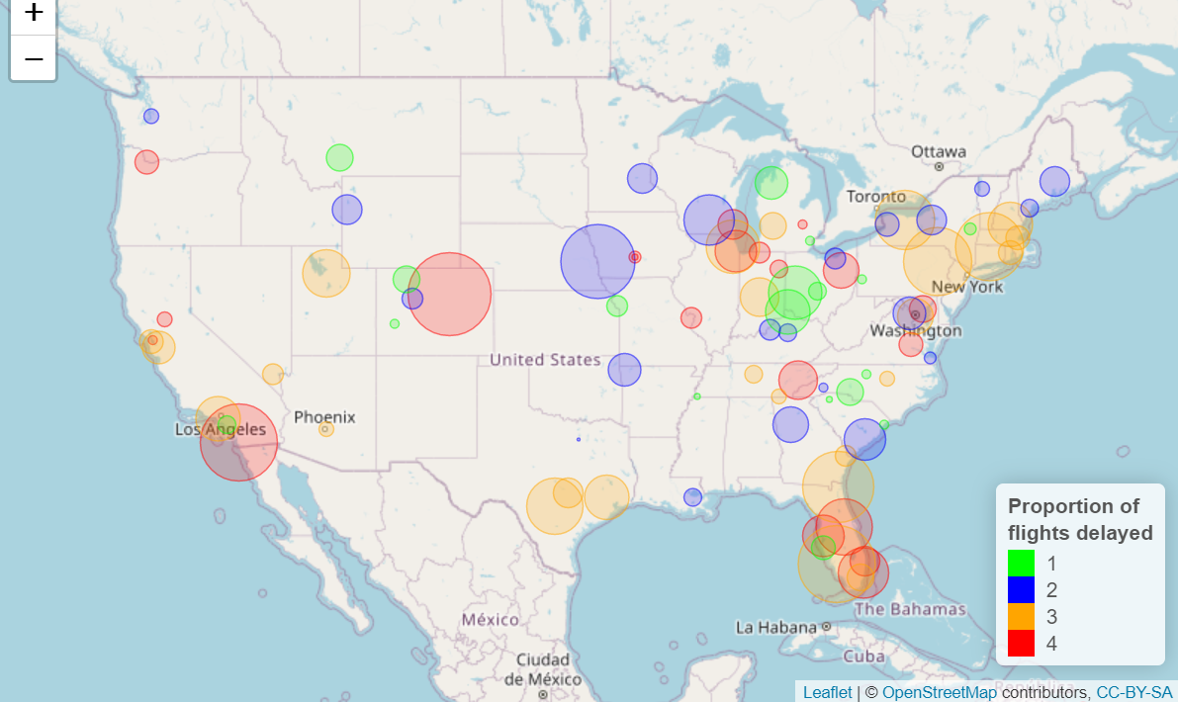
Airport location

Slide 10
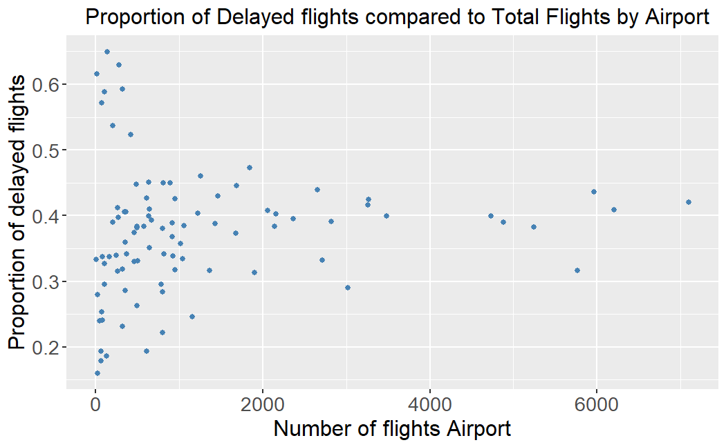
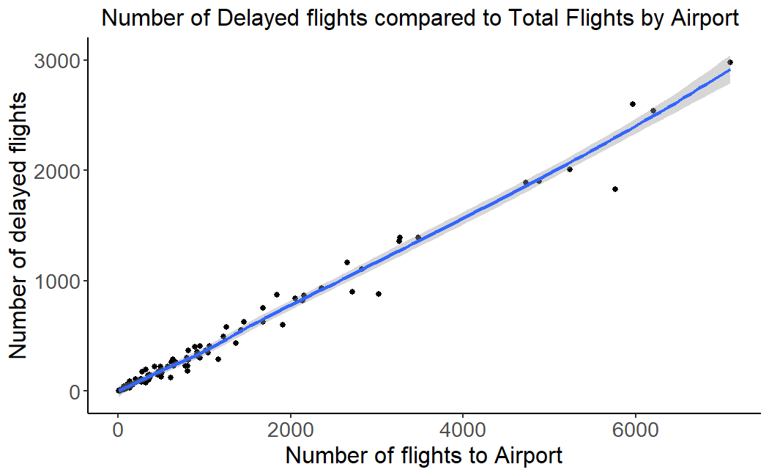
Flight frequency and delays

Slide 11
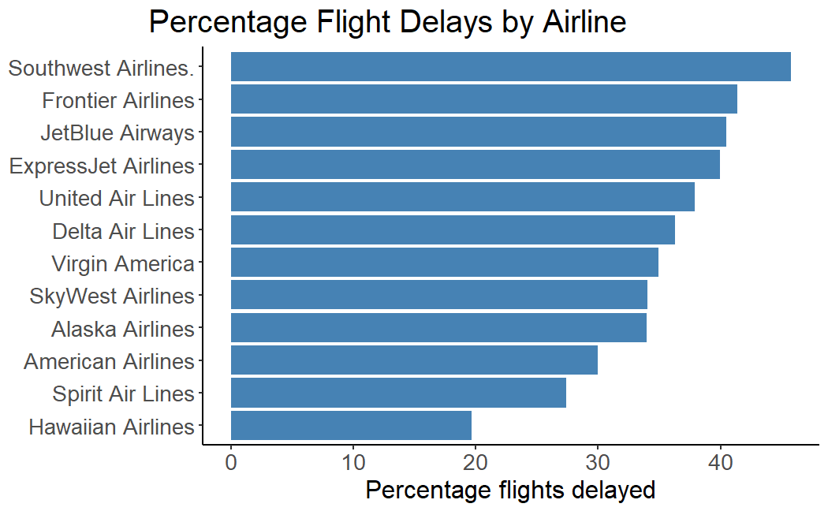
Aircraft and carrier

Slide 12
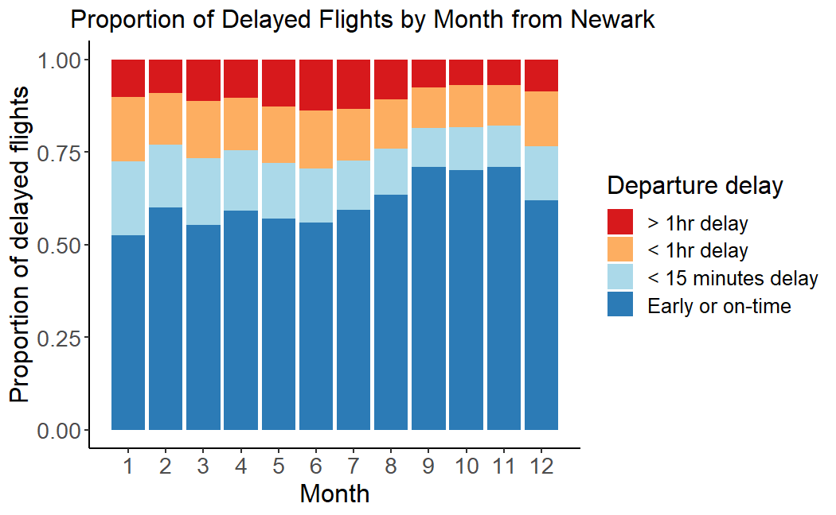
Time of year

Slide 13
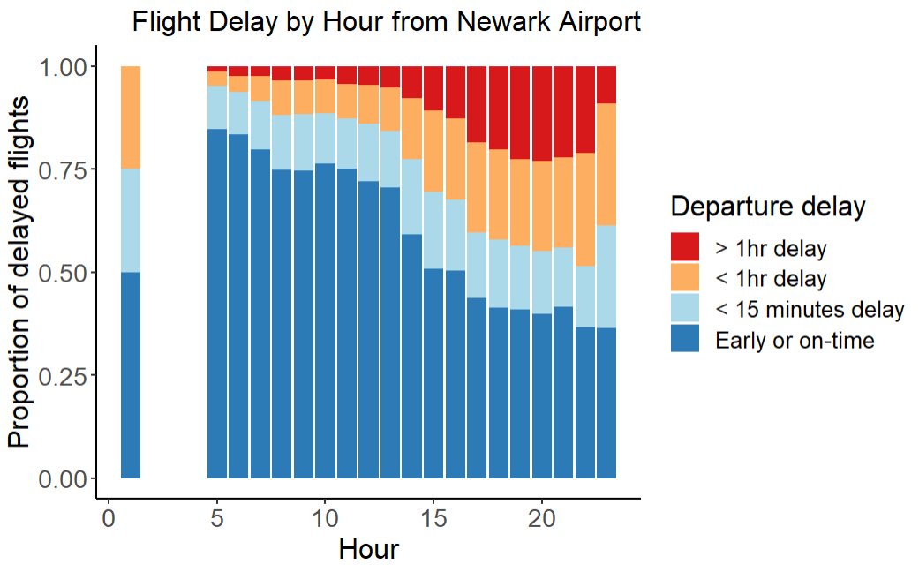
Flight delay by time of day

Slide 14
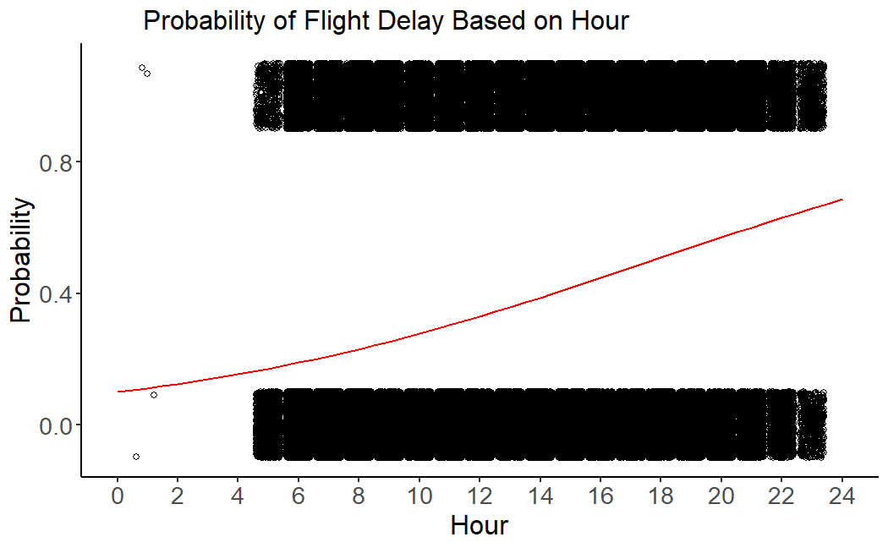
Simple Logistical regression with Hour as predictor
P-values < 0.01
ln(odds_{delayed}(x)) = -2.1996 + (0.1242 * x)
AUC Train = 0.6626
AUC Test = 0.6615

Slide 15
Conclusion and Actionable points
Weather does not impact flight delays
Main delays are correlated to time of the day of the flight
There were some seasonal variation in flight delay
Flight delay varied widely with airline carrier
Questions?

Slide 16
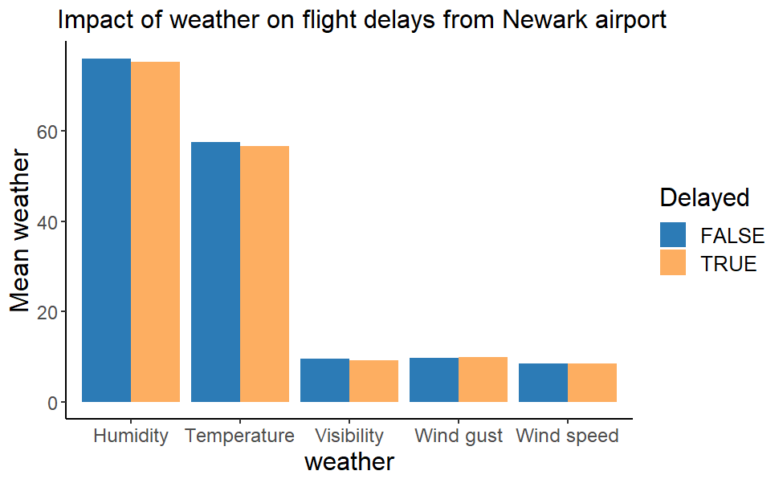
Comparison of weather types of flight delays

Slide 17
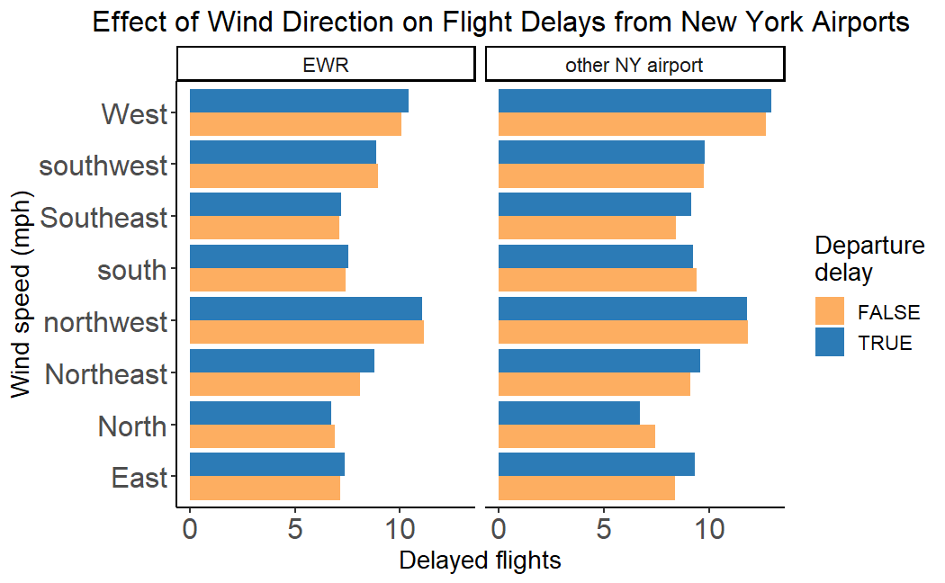
Wind direction

Slide 18
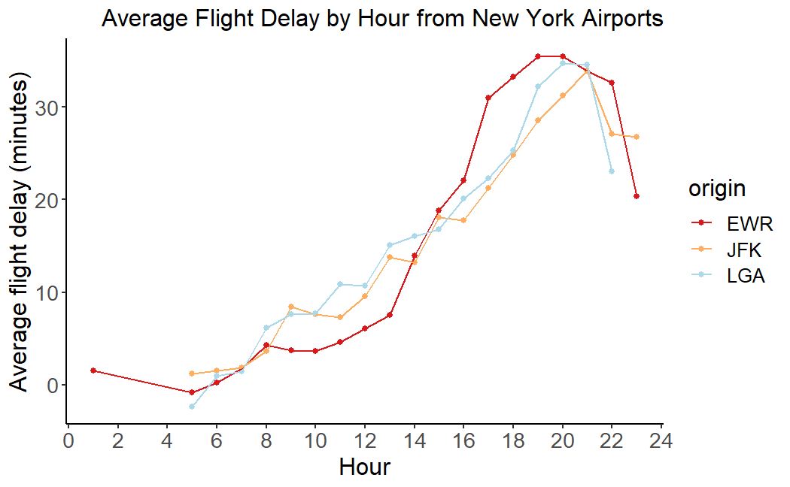
Delay for New York Airports by hour

Slide 19
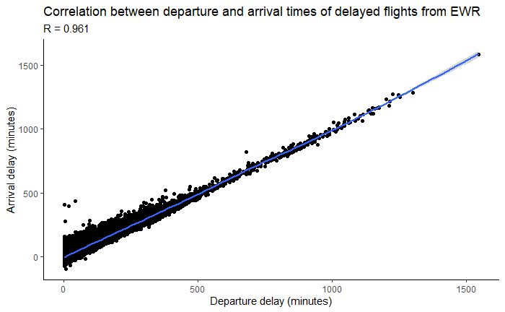
Delay flight distribution and impact
High correlation between departure and arrival delay
Similar for other New York airports

